Slide 1
Computing Longest Previous Factor in linear time and applications
Maxime Crochemore and Lucian Ilie
Information Processing Letters, Vol. 106, pp. 75-80, 2008
Presenter: Yung-Hsing Peng
Date: May 28, 2008

Slide 2
Abstract
We give two optimal linear-time algorithms for computing the Longest Previous Factor (LPF) array corresponding to a string w. For any position i in w, LPF[i] gives the length of the longest factor of w starting at position i that occurs previously in w. Several properties and applications of LPF are investigated. They include computing the Lempel-Ziv factorization of a string and detecting all repetitions (runs) in a string in linear time independently of the integer alphabet size.

Slide 3
The Longest Previous Factor
LPF[i] = max({ l | T[i..i+l–1] is a substring of T[0..i+l–2]}, 0)
Ex: a b b a a b b b a a a b a b
T[0..i+l–2]
LPF[7] =
3
Goal: Compute each LPF[i], for 0 ≤ i ≤ n–1
Brute force: O(n³) time

Slide 4
Suffix Array
T = agagt
∑ = {a, g, t}
ag
t
g
S₁ | agagt
S₂ | gagt
S₃ | agt
S₄ | gt
S₅ | t
5
agt
t
agt
t
1
3
2
4
Lexical order DFS
AT = [1, 3, 2, 4, 5] (sorted indices)
LT = [0, 2, 0, 1, 0] (array of lcp)
Suffix array contains AT and LT, which also takes O(n) space.
It takes O(|P|+U+logn) time to report all positions of P in T.

Slide 5
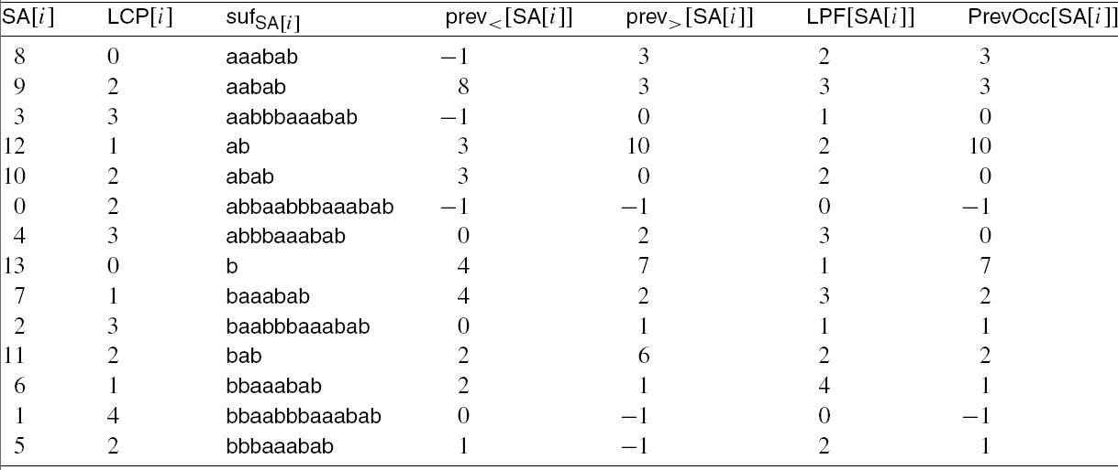
Computing LPF
LPF[7]: Compute max(LCP(suf₄, suf₇), LCP(suf₂, suf₇))
= max(min(1,0), min(3)) = 3
Brute force: O(n²) time with a suffix array

Slide 6
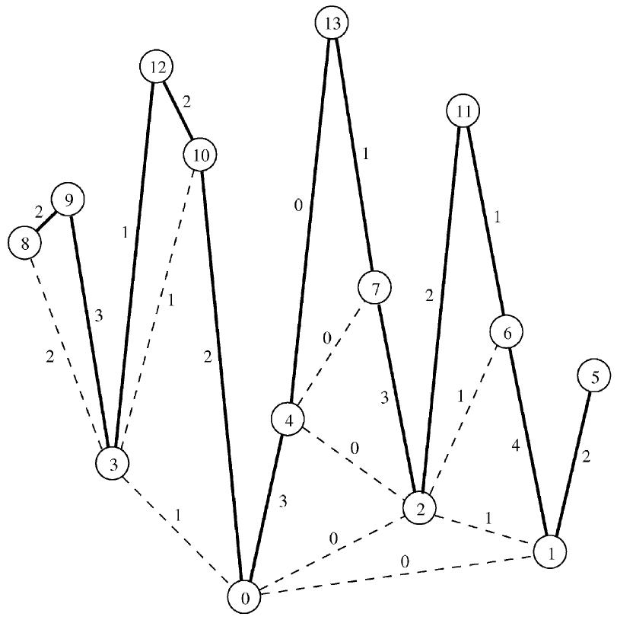
Conceptual Graph for the Suffix Array
Node: suffix
Edge: LCP
LPF[7]: = max(0, 3) = 3
Idea: O(n) time with a stack! (left to right)

Slide 7
Result for LPF
Given a string T of length n, the LPF array of T can be built in O(n) time. (this paper)
Proposition: The LPF array is a permutation of the LCP array. (from the conceptual graph)
Application of LPF:
Computing the Lempel-Ziv factorization
Computing runs in linear time

Slide 8
The Lempel-Ziv factorization
Given a string T of length n, the Lempel-Ziv factorization of T can be obtained in O(n) time with the LPF array of T.
Ex: a b b a a b b b a a a b a b
Lempel-Ziv factorization is an important technique for data compression.
LPF[5] = 2
LPF[10] = 2
LPF[i] = 1
LPF[7] = 3
LPF[12] = 2

Slide 9
Maximal Repetition (Runs) of a String
A maximal repetition w^{e} (run) in a word, with the period w for e ≥ 2, is a repetition such that its extension by one letter to the right or to the left yields a word with a bigger period.
Ex: T = a b a a b a b a a b a a b
Maximal runs in T:
(a b)^{5/2} = a b a b a (period 2)
(a b a)^{8/3} = a b a a b a a b (period 3)
(a b a a b)^{11/5} = a b a a b a b a a b a (period 5)
(a)² = a a (period 1)

Slide 10
Application of LPF on Finding Runs
Given a string T of length n, the runs of T can be obtained in O(n) time with the LPF array of T.
R. Kolpakov, G. Kucherov, Finding maximal repetitions in a word in linear time, in: Proc. Of FOCS’99, IEEE Computer Society Press, 1999, pp. 596-604.
Runs are useful for data compression.

